Slide 1


Ilia German
https://github.com/GermanIlia
DevOps & ALM consultant
https://www.linkedin.com/in/iliagerman/
PULUMI
https://pulumi.io

Slide 2

AGENDA
What is Pulumi? & IAC
Why Pulumi?
Pulumi vs Others
How Pulumi Works?
CI-CD With Pulumi
Deploying and managing EKS

Slide 3
WHAT IS PULUMI?
Pulumi is an open source cloud development platform, providing the cloud’s first true programming model using real programming languages for all major cloud providers.
Notes:
Supported languages: JS (TS), GO, Python

Slide 4
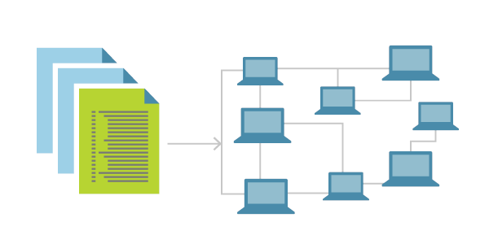
IAC
Infrastructure as Code (IaC) is the management of infrastructure in a descriptive model, using the same versioning as DevOps team uses for source code. Like the principle that the same source code generates the same binary, an IaC model generates the same environment every time it is applied.
Notes:
Infrastructure as Code evolved to solve the problem of environment drift in the release pipeline
Idempotence is a principle of Infrastructure as Code
Idempotency is achieved by either automatically configuring an existing target or by discarding the existing target and recreating a fresh environment.
Teams who implement IaC can deliver stable environments rapidly and at scale.

Slide 5
WHY PULUMI?
Unify development and Devops practices to define, deploy, and manage cloud apps and infrastructure.
Familiar Languages
Programming Model
Reusable Packages
Multi Cloud
Enterprise Grade
Deploy Continuously

Slide 6


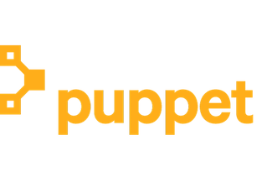
PULUMI VS CM TOOLS
Chef, Puppet, Ansible, and Salt are all popular configuration management tools. They do not attempt to solve the problem of provisioning or updating infrastructure, containers, or serverless resources.

Slide 7
PULUMI VS TERRAFROM
Terraform is the closest comparison to Pulumi. In Terraform, you write programs in DSL called HCL, and the Terraform engine takes care of provisioning and updating resources, very similar to Pulumi. In fact, thanks to integration with Terraform, Pulumi is able to support a superset of the cloud and service providers that Terraform currently offers.
Notes:
DSL = Domain specific language
HCL = Hashicorp Configuration Language (HCL)

Slide 8
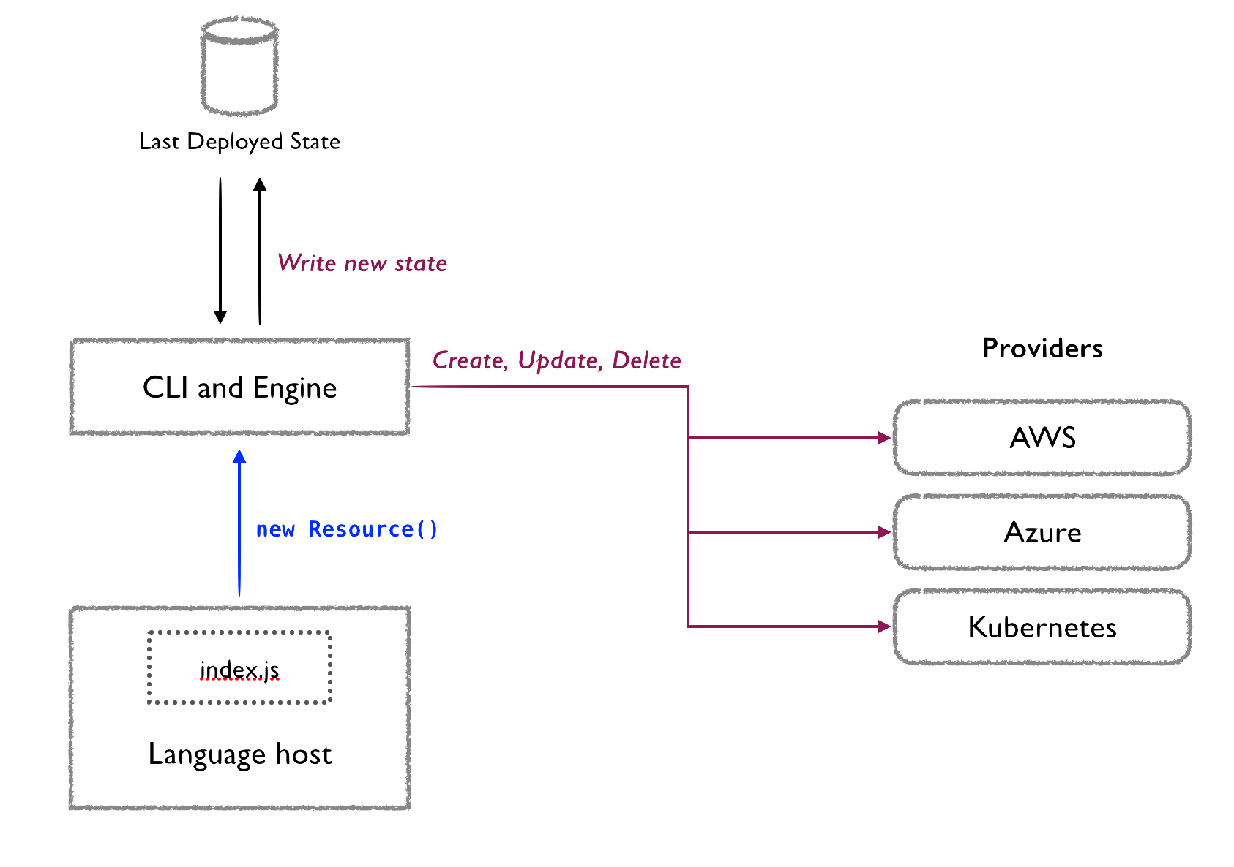
HOW PULUMI WORKS?
The host interacts with the Pulumi engine which determines which resources changes to perform. During the execution resource creation is registered and if not exists it is created.

Slide 9
PULUMI STACKS
Every Pulumi program is deployed to a stack. A stack is an isolated, independently configurable instance of a Pulumi program. Stacks are commonly used to denote different phases of development.
Notes:
Works with all major cloud providers

Slide 10
HELLO WORLD – SIMPLE WEBSERVER

Slide 11
PULUMI CLOUD CONSOLE
The Pulumi cloud console allows you to manage your stacks online. It enables you to collaborate with multiple developers, protect against concurrent updates, store resource history, integrate with you CI/CD system and more!
Notes:
Works with all major cloud providers

Slide 12
CLOUD CONSOLE
Notes:
https://app.pulumi.com/germanilia

Slide 13
CI / CD WITH PULUMI
Pulumi is great for continuous deployment and supports a range of workflows. The easiest way to achieve a Pulumi-based CD flow is to simply integrate it into your existing CI process.

Slide 14
CD PROCCESS – JENKINS
Notes:
http://sdp-jenkins.com:8080

Slide 15
EKS
The Kubernetes provider for Pulumi can be used to provision any of the resources specified by the Kubernetes API.
Notes:
http://localhost:8001/api/v1/namespaces/kube-system/services/https:kubernetes-dashboard:/proxy/#!/login

Slide 16
DEPLOY TO EKS (JENKINS)

Slide 17
TERRAFORM TO PULUMI
The goal of tf2pulumi is to help users efficiently convert Terraform-managed infrastructure into Pulumi stacks. It translates HCL configuration into Pulumi TypeScript programs. In the fullness of time, it will also translate Terraform state files into Pulumi checkpoint files.

Slide 18
WRAP UP

